Slide 1
Maven
Maven simplifies and standardizes the project build process.
It handles compilation, distribution, documentation, team collaboration and other tasks seamlessly.
Maven can build multiple projects together, publish projects information, deploy projects, share JARs across several projects and help in collaboration of teams.

Slide 2
Maven
Maven project structure and contents are declared in an xml file, pom.xml referred as Project Object Model (POM), which is the fundamental unit of the entire Maven system.
Much of the project management and build related tasks are maintained by Maven plugins.

Slide 3
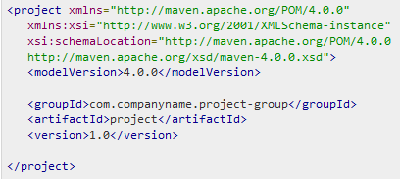

Maven
POM (Project Object Model) is an XML file that contains information about the project, goals and plugins. It always resides in the base directory of the project as pom.xml.
Maven reads the POM in the current directory, then executes a phase or goal.
Some of the configuration that can be specified in the POM are following:
dependencies
plugins
goals
build profiles
project version
developers
mailing list

Slide 4
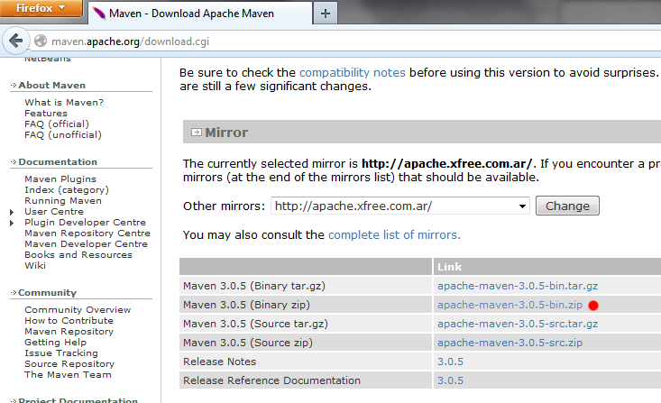
Maven – Install
Download Maven from “maven.apache.org

Slide 5
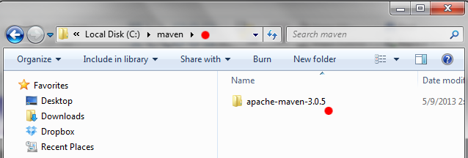
Maven – Install
Uncompress and copy to any folder

Slide 6
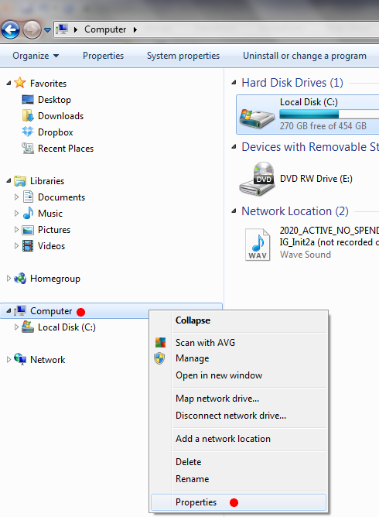
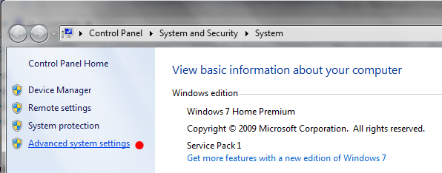
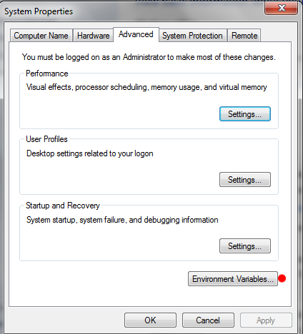
Maven – Install
Go to Environment Variables

Slide 7
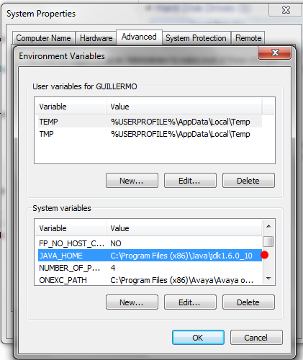
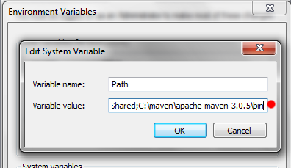
Maven – Install
In Environment Variables set JAVA_HOME
And also add maven’s “bin” directory to PATH

Slide 8
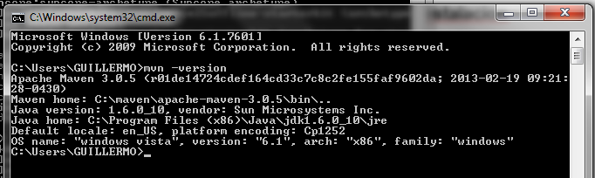
Maven – Install
Check maven installation running from the command line:
mvn -version

Slide 9
Maven – Create Project
Before creating a POM, we should first decide the project group (groupId), its name(artifactId) and its version as these attributes help in uniquely identifying the project in repository.
<project xmlns="http://maven.apache.org/POM/4.0.0"
xmlns:xsi="http://www.w3.org/2001/XMLSchema-instance"
xsi:schemaLocation="http://maven.apache.org/POM/4.0.0
http://maven.apache.org/xsd/maven-4.0.0.xsd">
<modelVersion>4.0.0</modelVersion>
<groupId>com.companyname.project-group</groupId>
<artifactId>project</artifactId>
<version>1.0</version>
</project>

Slide 10

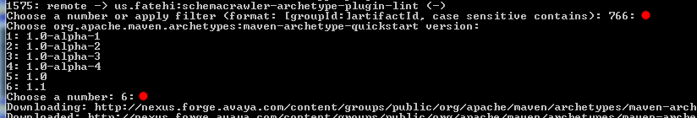
Maven – Create Project
Ir al worksapce y ejecutar
mvn archetype:generate
Ingresar <enter> in “Choose a number or appy filter …….: 766:
Ingresar <enter> in “Choose a number: 6:

Slide 11


Maven – Create Project
Ingresar el <groupId>, por lo general ‘com.avaya.ept’
Ingresar como <artifactId>. El nombre del proyecto Java
Ingresar ‘1.0 <versión>
Ingresar <enter> en los prompts restantes confirmando el valor:

Slide 12
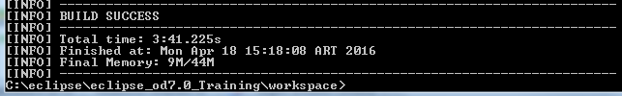
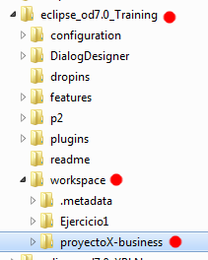
Maven – Create Project
Si la creación del proyecto es exitosa, aparecerá este mensaje
Y en el workspace la carpeta ya estará creada

Slide 13
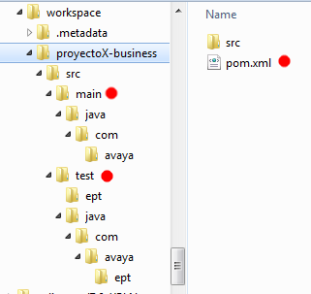
Maven – Create Project
When a Maven project is created, Maven creates default project structure: source code files, resource files and other configurations.
Created with archetype generation:
source code | ${basedir}/src/main/java
tests | ${basedir}/src/test
Created manually:
resources | ${basedir}/src/main/resources
Created at compilation time:
distributable JAR | ${basedir}/target
complied byte code | ${basedir}/target/clases

Slide 14


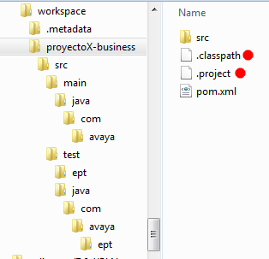
Maven – Create Project
The Project is created and needs to be setup for Eclipse, running from the project folder ‘mvn eclipse:eclipse'
This creates the ‘.classpath”’and ‘.project’ files.

Slide 15
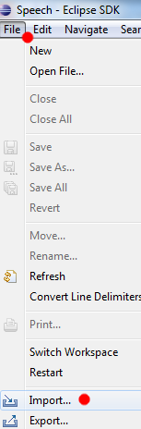
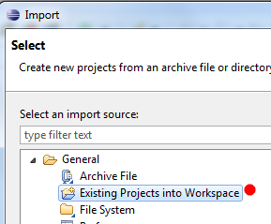
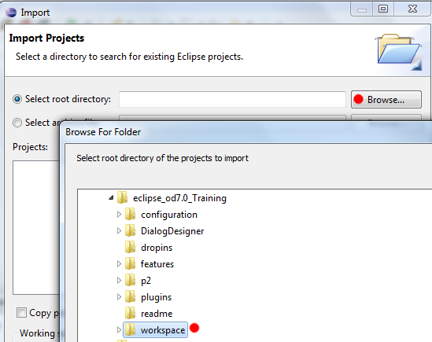
Maven – Create Project
Now we are ready to go to Eclipse and ‘import’ the project by ‘File -> Import -> Existing Projects into Workspace’

Slide 16
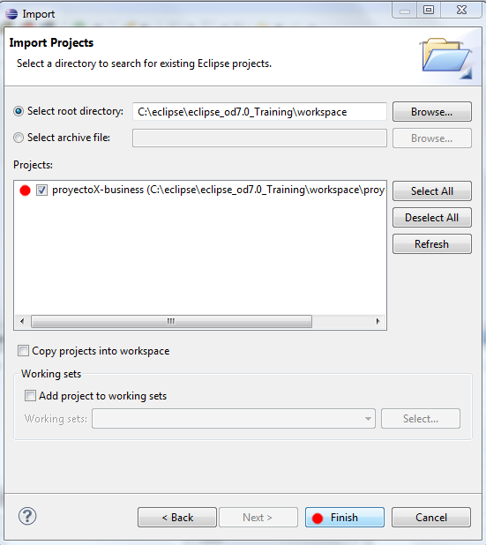
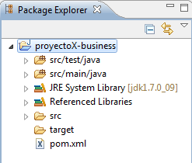
Maven – Create Project
Select the project in the list and make sure that ‘Copy project inot workspace’ is UNCHECKED

Slide 17
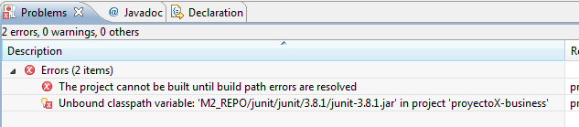
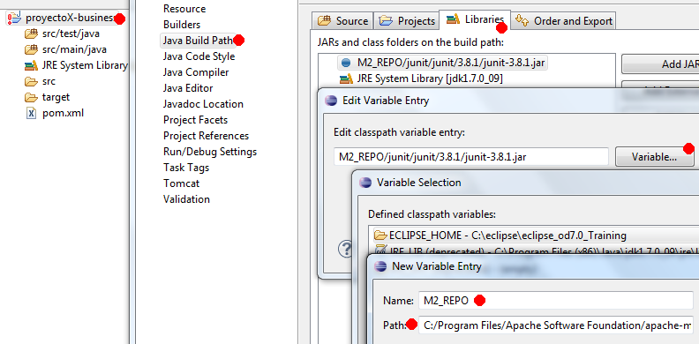
Maven – Create Project
If a compilation error appears, make sure that the M2_REPO variable is set correctly at the project’s Build Path.

Slide 18
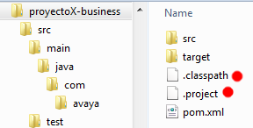
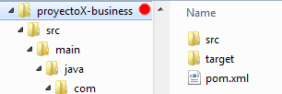
Maven – Eclipse update
Delete the ‘.classpath”’and ‘.project’ files -> ‘mvn eclipse:clean’ (not much used)
Antes Despues

Slide 19
Maven – Eclipse update
Create/Update the ‘.classpath”’and ‘.project’ files (i.e. when pom.xml is changed) -> ‘mvn eclipse:eclipse’
Once done refresh the project in Eclipse by pressing ‘F5’

Slide 20
Maven – Repositories
Local Repository
Folder location on your machine
Central Repository (Maven Central)
Provided by Maven community

Slide 21
Maven – Repositories
Local Repository
Is a folder location on your machine, where Maven keeps your project's all dependencies (library jars, plugin jars etc). When you run a Maven build, then Maven automatically downloads all the dependency jars into the local repository.

Slide 22
Maven – Repositories
Central Repository (Maven Central)
Is a repository provided by Maven community. When Maven does not find any dependency in local repository it searches in this central repository.
This repository is managed by Maven community.
It is not required to be configured.
It requires internet access to be searched.

Slide 23
Maven – Repositories
Custom Repository (Avaya Central)
Maven can be configured to use a different repository instead of Maven Central, such as Avaya ‘nexus’ repository.
This configuration can be performed in two different ways:
Through the Maven configuration file
In the project’s pom.xml file

Slide 24
Maven – Build Lifecycle
A basic Maven Build Lifecycle consists of following sequence of phases:
Validate
Validates whether project is correct and all necessary information is available to complete the build process.
Compile
Source code compilation. Compiles what is in “src” (.java, .properties, etc.) and places the compilation in “target” (.java is now.class)
Package
Creates the JAR / WAR files. Takes what is in “target” (.class, .properties, etc.), generates a jar or war with all the files in the same “target” folder.
These JAR / WAR files are to be deployed to Tomcat/Weblogic
Install
Installs the package (.jar) in the local maven repository.
When a phase is called via Maven command, for example mvn compile, only phases upto and including that phase will execute.

Slide 25
Maven – Build Lifecycle
Lifecycle Phase | Description
validate | Validates whether project is correct and all necessary information is available to complete the build process.
initialize | Initializes build state, for example set properties
generate-sources | Generate any source code to be included in compilation phase.
process-sources | Process the source code, for example, filter any value.
generate-resources | Generate resources to be included in the package.
process-resources | Copy and process the resources into the destination directory, ready for packaging phase.
compile | Compile the source code of the project.
process-classes | Post-process the generated files from compilation, for example to do bytecode enhancement/optimization on Java classes.
generate-test-sources | Generate any test source code to be included in compilation phase.
process-test-sources | Process the test source code, for example, filter any values.
test-compile | Compile the test source code into the test destination directory.
process-test-classes | Process the generated files from test code file compilation.
test | Run tests using a suitable unit testing framework(Junit is one).
prepare-package | Perform any operations necessary to prepare a package before the actual packaging.
package | Take the compiled code and package it in its distributable format, such as a JAR, WAR, or EAR file.
pre-integration-test | Perform actions required before integration tests are executed. For example, setting up the required environment.
integration-test | Process and deploy the package if necessary into an environment where integration tests can be run.
post-integration-test | Perform actions required after integration tests have been executed. For example, cleaning up the environment.
verify | Run any check-ups to verify the package is valid and meets quality criterias.
install | Install the package into the local repository, which can be used as a dependency in other projects locally.
deploy | Copies the final package to the remote repository for sharing with other developers and projects.

Slide 26
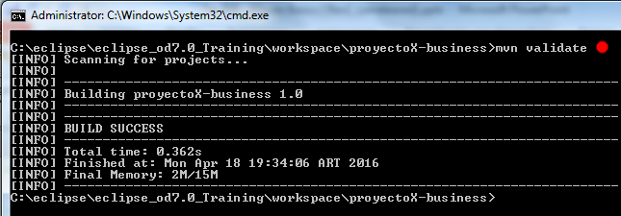
Maven – Build Lifecycle
mvn validate
validate only

Slide 27
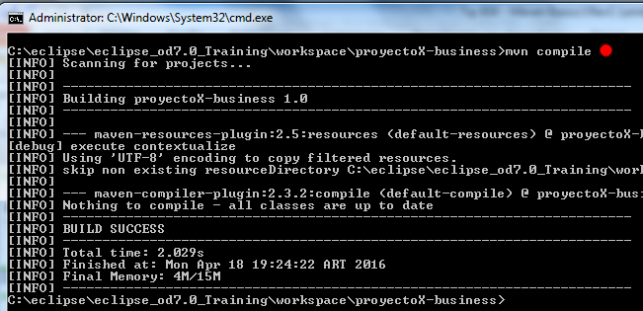
Maven – Build Lifecycle
mvn compile
compile

Slide 28
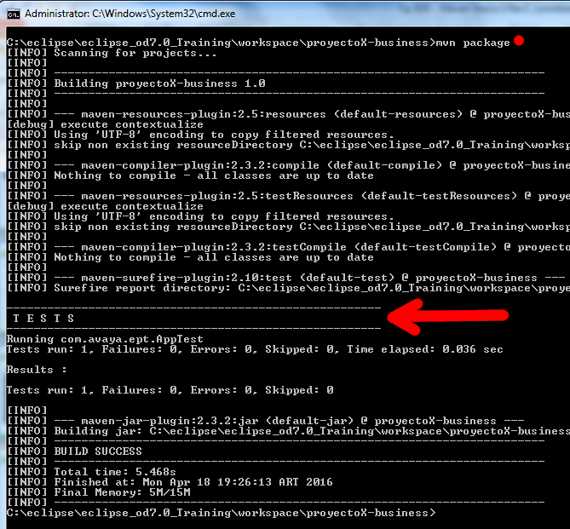
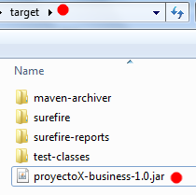
Maven – Build Lifecycle
mvn package
compile
run Unit Tests
package

Slide 29
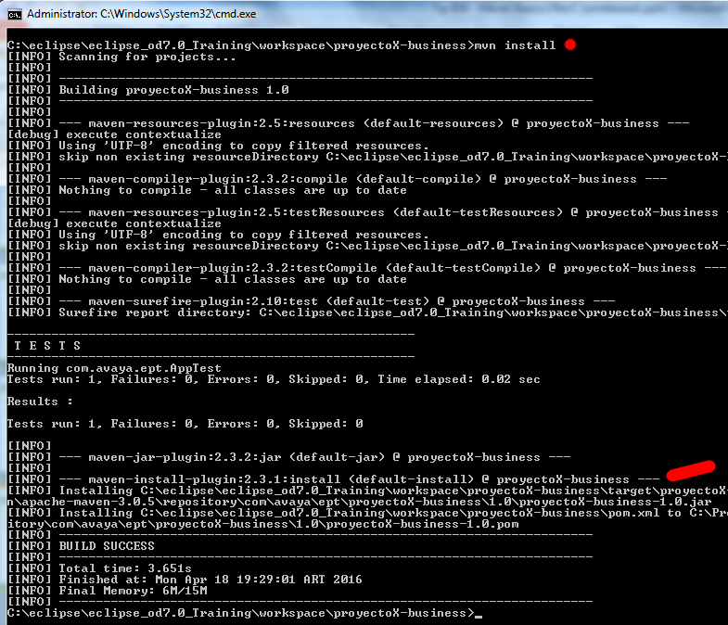
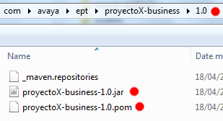
Maven – Build Lifecycle
mvn install
compile
run Unit Tests
package
install

Slide 30
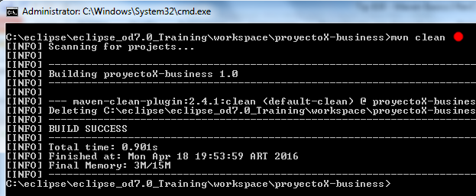
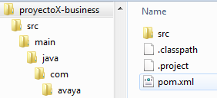
Maven – Clean Lifecycle
mvn clean

Slide 31
Maven – Lifecycles, Phases & Goals
Lifecycles have Phases
Phases have Goals

Slide 32
Maven – Lifecycles, Phases & Goals
Lifecycles
Build (Default)
Clean
Site

Slide 33
Maven – Phases and Goals
When you execute the ‘mvn’ command you can specify a ‘Phase’ or a ‘Goal’, regardless of the ‘Lifecycle’ !!!!
Examples:
‘mvn clean’
executes the phase named ‘clean’
‘mvn clean:clean’
Using the plugin ‘clean’ executes the goal also named ‘clean’

Slide 34
Maven – Phases and Goals
Goals are executed in phases.
The compile phase goals will always be executed before the test phase goals which will always be executed before the package phase goals and so on.
If you specify a phase then maven will run all phases up to the phase, and for each phase it will run all goals attached to that phase.
If you specify a goal when you execute Maven then it will still run all phases up to the phase for that goal.

Slide 35
Maven – Lifecycles, Phases & Goals
Phases of
Build (Default) Lifecycle
validate -> initialize -> generate-sources -> process-sources -> generate-resources -> process-resources -> compile -> process-classes -> generate-test-sources -> process-test-sources -> generate-test-resources -> process-test-resources -> test-compile -> process-test-classes -> test -> prepare-package -> package -> pre-integration-test -> integration-test -> post-integration-test -> verify -> install -> deploy</phase>

Slide 36
Maven – Lifecycles, Phases & Goals
Phases of
Clean Lifecycle
pre-clean -> clean -> post-clean

Slide 37
Maven – Lifecycles, Phases & Goals
Phases of
Site Lifecycle
pre-site -> site -> post-site -> site-deploy

Slide 38
mvn [plugin-name]:[goal-name]
Maven – Plugins
Maven is a plugin execution framework.
Plugins do :
create jar file
create war file
compile code files
unit testing of code
create project documentation
create project reports
A plugin can be executed like this:
mvn [plugin-name]:[goal-name]

Slide 39
mvn [plugin-name]:[goal-name]
Maven – Plugins
Plugin types:
Build plugins
They execute during the build and should be configured in the <build/> element of pom.xml
Reporting plugins
They execute during the site generation and they should be configured in the <reporting/> element of the pom.xml

Slide 40
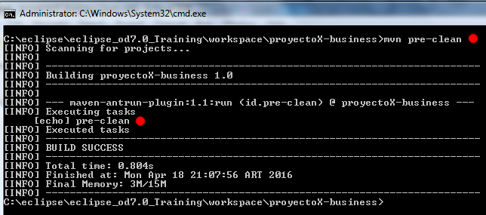
mvn [plugin-name]:[goal-name]
Maven – Plugins
Plugin example for clean lifecycle:

Slide 41
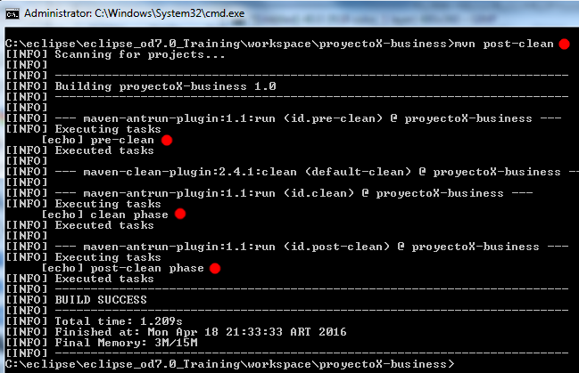
mvn [plugin-name]:[goal-name]
Maven – Plugins
Plugin example for clean phase:

Slide 42
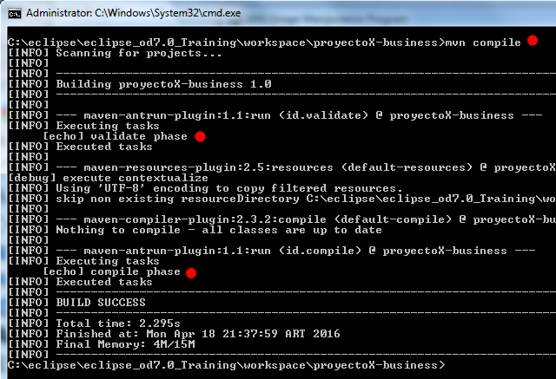
mvn [plugin-name]:[goal-name]
Maven – Plugins
Plugin example for build lifecycle:

Slide 43
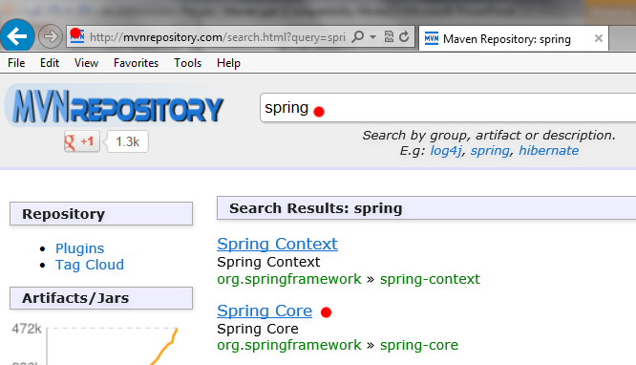
Maven – Dependencies
Copy dependencies from mavenrepository.com
(example for “spring”)

Slide 44
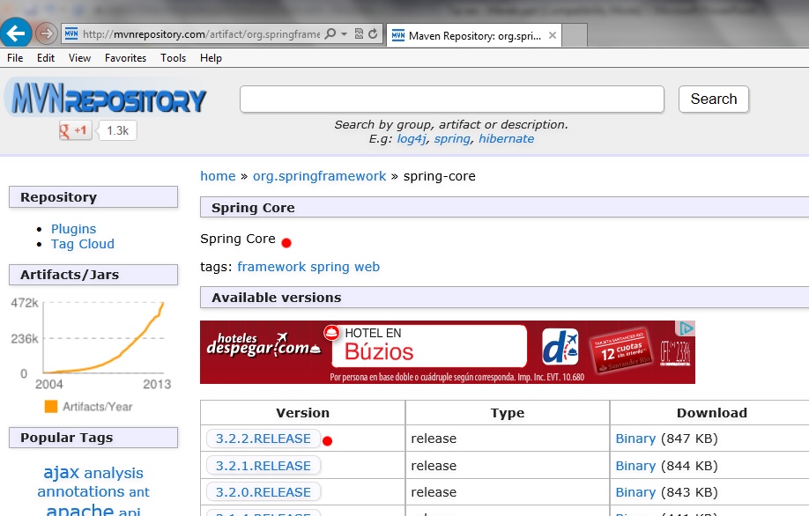
Maven – Dependencies
Choose the correct version

Slide 45
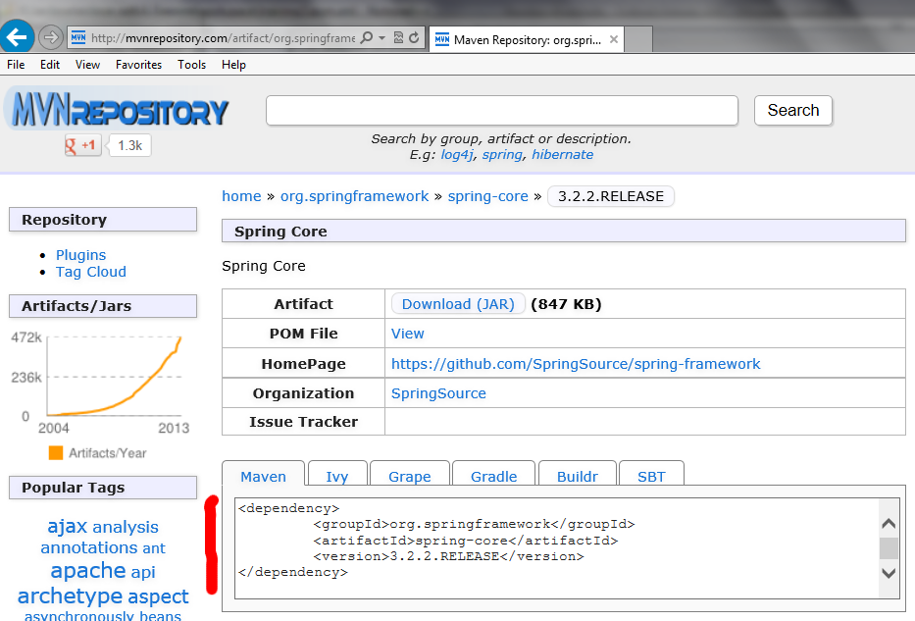
Maven – Dependencies
‘Cut&Paste’ the dependencyversion

Slide 46
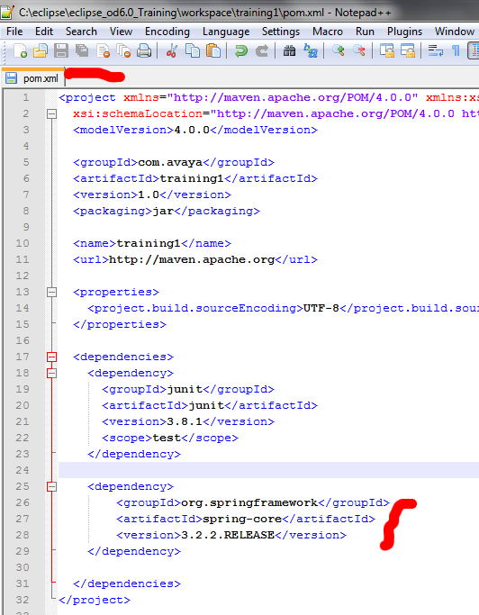
Maven – Dependencies
Insert the dependency un the project pom.xml

Slide 47
Maven
El ‘pom.xml”’puede invocar a otros ‘pom.xml’ por:
Herencia
<parent>
<groupId>com.avaya</groupId>
<artifactId>AvayaPomLibraryApp</artifactId>
<version>1.0</version>
</parent>
Dependencia
<dependency>
<groupId>com.avaya</groupId>
<artifactId>Workshop_Business</artifactId>
<version>1.0</version>
<type>jar</type>
</dependency>
Modulo
<modules>
<module>Workshop_Business</module>
<module>Workshop_BusinessImpl</module>
<module>Workshop_BusinessMock</module>
</modules>

